Slide 1
St Matthew’s RC Primary School
Miss Anna Chidgey
Head teacher
P1 Transition Info
WE ARE THE FUTURE

Slide 2
School Vision At St Matthew’s we aspire to create an outstanding positive ethos based on the Gospel Values and respect for all. We will provide a safe learning environment that encourages learners to discover and challenge their thinking. Through high quality learning and teaching, we will promote curiosity and ignite a passion for life-long learning, developing independent learners who embrace challenge enthusiastically. We endeavour to ensure our learners develop their skills and confidence and reach their full potential in preparation for the future.

Slide 3
School Values Faith Honesty Integrity Respect Responsibility Forgiveness Friendship

Slide 4
School Aims
A school environment, where all members of the school community feel valued and respected, where the health and wellbeing of all are nurtured, fostering a sense of high self esteem and motivation within a secure and positive ethos.
Providing the highest quality teaching and learning environment, where both staff and children set high expectations for themselves and become successful, reflective learners across the curriculum.
Offering our children a wide range of learning experiences, which give opportunities to learn about issues such as sustainable development, citizenship, enterprise, the arts, which develops a greater understanding of the world around them and a sense of their place in the world.

Slide 5
School Aims - Continued
Encouraging staff and children to be creative thinkers to enable them to meet new challenges and situations with confidence.
To work closely with the parish of St. Matthew’s, supporting one another in nurturing the Gospel values and embracing the Christian ethos as well as preparing our children to receive the sacraments.
To plan, monitor and evaluate each aspect of school life on a regular basis to ensure our children are being offered the very best teaching and learning experience.
To promote healthy and active living and embrace the principles of a health promoting school.

Slide 6
Staffing 2021 – 2022
Head Teacher Miss Chidgey
Principal Teacher Mrs Syme
Primary 1 To be confirmed
School Office Mrs Golder

Slide 7
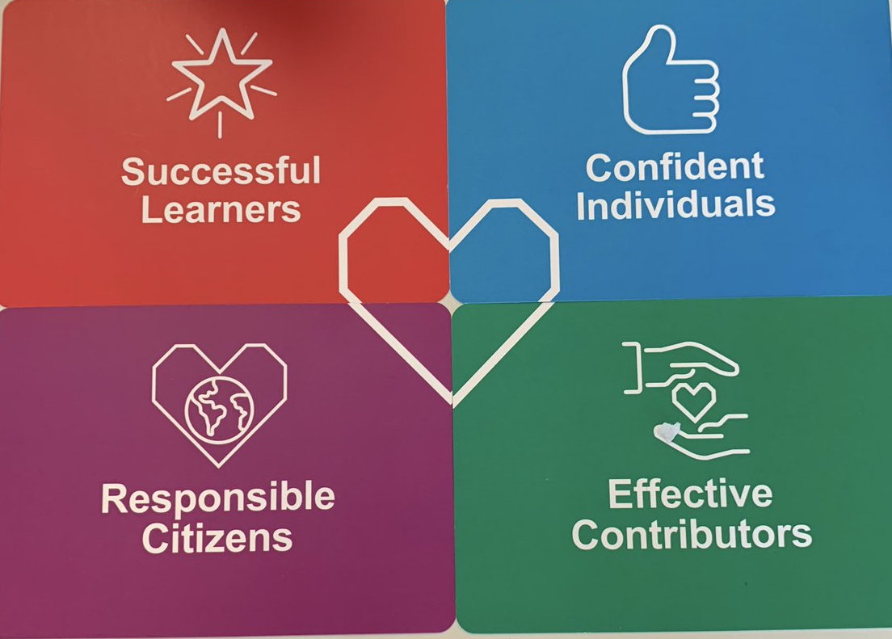
Curriculum for Excellence
Curriculum for Excellence is Scotland's curriculum for children and young people aged 3-18. It's an approach designed to provide young people with the knowledge, skills and attributes they need for learning, life and work in the 21st century.
It aims to enable every child or young person to be:
Notes:
You’re just trying to get your house in order when … bam! Someone’s up knocking at your door!

Slide 8
Curriculum for Excellence
The Curriculum for Excellence covers eight curricular areas:
Literacy and English
Numeracy and Mathematics
Health and Wellbeing
Religious Education
Expressive Arts
Social Subjects
Science
Technologies
Notes:
You’re just trying to get your house in order when … bam! Someone’s up knocking at your door!

Slide 9
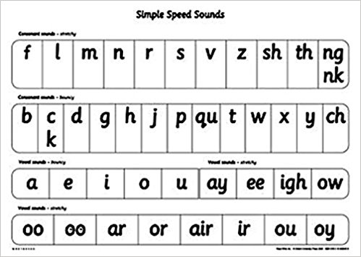
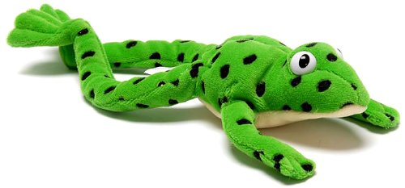
Phonics At St Matthew’s, we follow the Read Write Inc. Phonics programme to teach your child to read:
We hope to host a RWI Parents Workshop in the first term to give you more information on our phonics programme. More information to follow.

Slide 10
Partnership with Parents
We look to include parents as much as possible in school life:
Open week
Enrolment Days
Induction days for children and adults
Curriculum event for Parents – Sept 2021 – date tbc
Newsletters and information
Meetings with HT, class teachers
School Uniform, PE Kit etc.
Life and work of the school and parish
Sharing the Learning Days & Assemblies
Parent Council
Parent Workshops
Notes:
You’re just trying to get your house in order when … bam! Someone’s up knocking at your door!

Slide 11
Communication
Information about our school and your child is communicated in a number of ways:
School Handbook
P1 Information packs (to be delivered to homes)
Curriculum workshops
Seesaw
School Website
Twitter account
Newsletters
Appointments
Text messaging service
Emails
Pupil post
Annual Report …. to name a few
Notes:
You’re just trying to get your house in order when … bam! Someone’s up knocking at your door!

Slide 12
Promoting Positive Behaviour
Whole School Positive Behaviour Policy
– included in Handbook
Tree of Recognition
Rights Respecting School – Class Charter
Rules for behaviour and for learning
House System
Being Cool in School
Support of Partner Agencies
Pupil Responsibilities
Assemblies
Celebration of Achievement
Celebration of children’s wider achievements
Pupil voice
Notes:
You’re just trying to get your house in order when … bam! Someone’s up knocking at your door!

Slide 13
Preparing for School Many parents ask us what they can do to help to prepare their child for Primary School. Below is a list of some of the things you could work on over the summer:
wash and dress themselves
zips/buttons etc
brush their own teeth
go to toilet
use a knife and fork
identify their full name
identify their own clothing (nametags or markings on all clothing)
practice writing full name, letters/numbers
responsibility for self
carry own school bag and homework bag
look at school website – P1 Transition tab – Virtual Tour of school, transition activities
continue to read and share books, poetry, comics, stories and songs, visit library
promoting positive behaviour – discuss different ways of dealing with challenging situations
maintain routines: night time, going to bed
organise uniform, homework, PE kit the night before
maintain morning routine getting ready for school
make healthy food choices: healthy breakfast, break-time snack and packed lunch

Slide 14
Your Next Steps
Talk to your child about school and expectations
Take them for a walk to school to see it and help to ease anxieties
Use the school website & twitter to stimulate discussion
Engage with the transition activities available in the virtual classroom on the website
Contact the school via email if you have any questions or concerns
Further information will follow from school regarding your child’s first day as a Primary 1 learner

Slide 15
Information The following information will be available either through our school website or will be delivered to your home in an information pack as soon as possible
School Handbook – available on school website
Active Schools Information Sheet
ParkSmart letter
Uniform – for information only – online ordering system
School session dates
Free School Meals & Clothing Grant forms to follow

Slide 16
Questions In the first instance, please consult our FAQ section in the P1 Transition section of the school website. If you can’t find the answer you’re looking for, please email any further questions to stmatthews_ps@midlothian.gov.uk

